Slide 1
CMSC201
Computer Science I for Majors
Lecture 05 – Algorithmic Thinking

Slide 2
Last Class We Covered
Decision structures
One-way (using if)
Two-way (using if and else)
Multi-way (using if, elif, and else)
Nested decision structures

Slide 3
Any Questions from Last Time?

Slide 4
Today’s Objectives
To practice thinking algorithmically
To understand and be able to implement proper program development
  To learn more about “bugs”
To get practice with decision structures
(Lots of practice)

Slide 5
What is an Algorithm?
Steps used to solve a problem
Problem must be
  Well defined
  Fully understood
  by the programmer
Steps must be
  Ordered
  Unambiguous
  Complete

Slide 6
Developing an Algorithm

Slide 7
Program Development
Understand the problem
Represent your solution (your algorithm)
  Pseudocode
  Flowchart
Implement the algorithm in a program
Test and debug your program

Slide 8
Step 1: Understanding the Problem
Input
  What information or data are you given?
Process
  What must you do with the information/data?
  This is your algorithm!
Output
  What are your deliverables?

Slide 9
“Weekly Pay” Example
Create a program to calculate the
weekly pay of an hourly employee
  What is the input, process, and output?
Input: pay rate and number of hours
Process: multiply pay rate by number of hours
Output: weekly pay

Slide 10
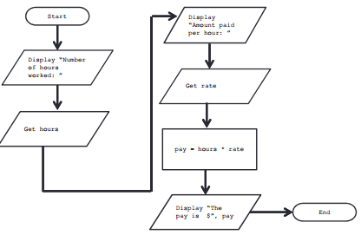
Step 2: Represent the Algorithm
Can be done with flowchart or pseudocode
Flowchart
  Symbols convey different types of actions
Pseudocode
  A cross between code and plain English
One may be easier for you – use that one

Slide 11
Flowchart Symbols
Start
Start Symbol
Input/Output
End
End Symbol
Decision Symbol
Data Processing Symbol
Flow Control Arrows

Slide 12
Step 2A: Flowchart
Start
Get the rate
Display “Number
of hours worked: ”
pay = hours * rate
Get the hours
Display “The pay
is $” , pay
Display “Amount
paid per hour: ”
End

Slide 13
Step 2B: Pseudocode
Start with a plain English description, then…
Display "Number of hours worked: "
Get the hours
Display "Amount paid per hour: "
Get the rate
Compute pay = hours * rate
Display "The pay is $" , pay

Slide 14
Steps 3 and 4: Implementation and Testing/Debugging
Implementing and testing/debugging your program are two steps that go hand in hand
After implementing, you must test it
After discovering errors, you must find them
  Once found, you must fix them
  Once found and fixed, you must test again

Slide 15
Algorithms and Language
Notice that developing the algorithm
didn’t involve any Python at all
  Only pseudocode or a flowchart was needed
  An algorithm can be coded in any language
All languages share certain tools that
can be used in your algorithms
  For example, control structures

Slide 16
Algorithmic Thinking
Algorithms are an ordered set of clear steps that fully describes a process
Examples from real life?
  Recipes
  Driving directions
  Instruction manual (IKEA)

Slide 17
Debugging

Slide 18
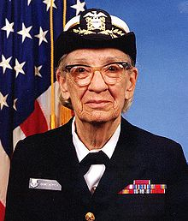
A Bit of History on “Bugs”
US Navy lab (Sep 1947)
Grace Hopper and her colleagues were working on the Harvard Mark II
  Instructions read one at a time from a tape
Or trying to… it wasn’t working right
Rear Admiral Grace Hopper
Image from wikimedia.org
Notes:
https://commons.wikimedia.org/wiki/File:Grace_Hopper.jpg

Slide 19
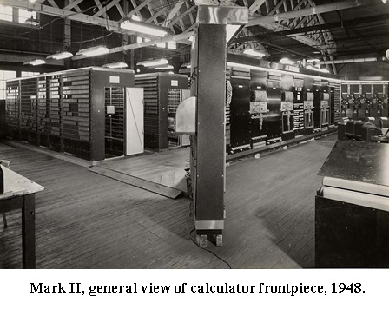
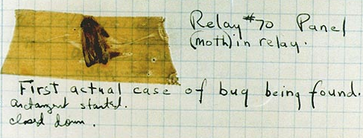
A Bit of History on “Bugs”
Mark II was a LARGE
machine that took up
an entire room
  You could open each panel and look inside
They found a literal bug
inside the machine
  Taped the bug (a moth)
  into their log book
Images from amhistory.si.edu and wikimedia.org
Notes:
http://amhistory.si.edu/archives/images/d8324-1.jpg
https://commons.wikimedia.org/wiki/File:H96566k.jpg

Slide 20

Errors (“Bugs”)
Two main classifications of errors
Syntax errors
  Prevent Python from
  understanding what to do
Logical errors
  Cause the program to run
  incorrectly, or to
  not do what you want
Image from pixabay.com
Notes:
https://pixabay.com/en/bug-computer-icon-sad-spider-1296767/

Slide 21
Syntax Errors
“Syntax” is the set of rules followed by a computer programming language
  Similar to grammar and spelling in English
Examples of Python’s syntax rules:
  Keywords must be spelled correctly
    True and False, not Ture or Flase or Truu
  Quotes and parentheses must be closed:
    ("open and close")

Slide 22
Syntax Error Examples
Find the syntax errors in each line of code below:
  1 prnit("Hello")
  2 print("What"s up?")
  3 print("Aloha!)
  4 print("Good Monring")

Slide 23
Syntax Error Examples
Find the syntax errors in each line of code below:
  1 prnit("Hello")
  2 print("What"s up?")
  3 print("Aloha!)
  4 print("Good Monring")
not actually a syntax error

Slide 24
Logical Errors
Logical errors don’t bother Python at all…
they only bother you!
Examples of logical errors:
  Using the wrong value for something
    currentYear = 2013
  Doing steps in the wrong order
    “Put the pan in the oven. Mix the wet and dry ingredients in the pan. Preheat the oven.”

Slide 25
Practicing Decision Structures

Slide 26

Exercise: PB&J Algorithm
English speaking aliens are visiting Earth for the first time. They want to know how to make a peanut butter and jelly sandwich.
Explicitly, what are the required steps for building a peanut butter and jelly sandwich?

Slide 27
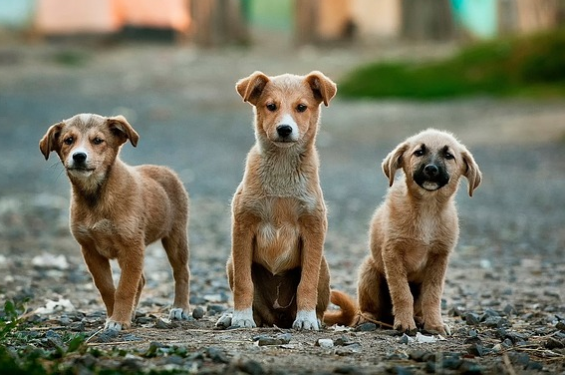
Exercise: Are Dogs Good?
Ask the user if a dog is a good dog
Print out one
response for “yes”
Print out a different
response for any
other answer
Image from pixabay.com
Notes:
https://pixabay.com/en/dogs-puppies-pet-animal-cute-984015/

Slide 28

Exercise: Nail Polish
Dr. Gibson has a LOT of nail polish
Write a game where the user guesses how many bottles she has, and tell them
whether their guess was high,
low, or correct
What info do you need?
  (She has 296 bottles)
Image from pixabay.com
Notes:
https://pixabay.com/en/manicure-pedicure-cosmetics-870857/

Slide 29

Exercise: Moving on to CMSC 202
Ask the user their major and the
grade they earned in CMSC 201
  Print out whether they can move
  on to CMSC 202 next semester
If they’re a CMSC or CMPE major
  They need an A or a B
Otherwise
  They need an A, B, or a C
Image from pixabay.com
Notes:
https://pixabay.com/en/question-mark-question-response-1019993/

Slide 30
Announcements
HW 2 is out on Blackboard now
  Complete the Academic Integrity Quiz to see it
  Due by Friday (Feb 17th) at 8:59:59 PM
Make sure to spell the dog breeds correctly!
  Will make it much easier for your TA to grade
Pre Lab 4 Quiz will come out Friday @ 10 AM
  Must be completed by 9 AM Monday morning

